Slide 1
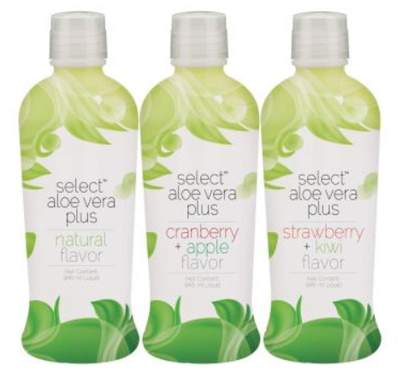
Notes:
销售的故事→卖甚么?

Slide 2
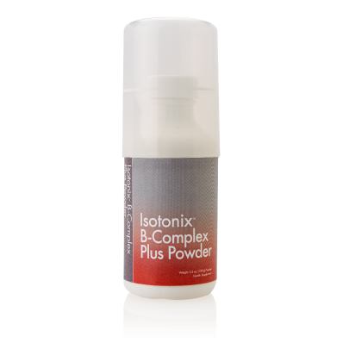
Notes:
超过120种独家代理的产品

Slide 3
Notes:
超过130家伙伴商店，包括生活种种消费

Slide 4
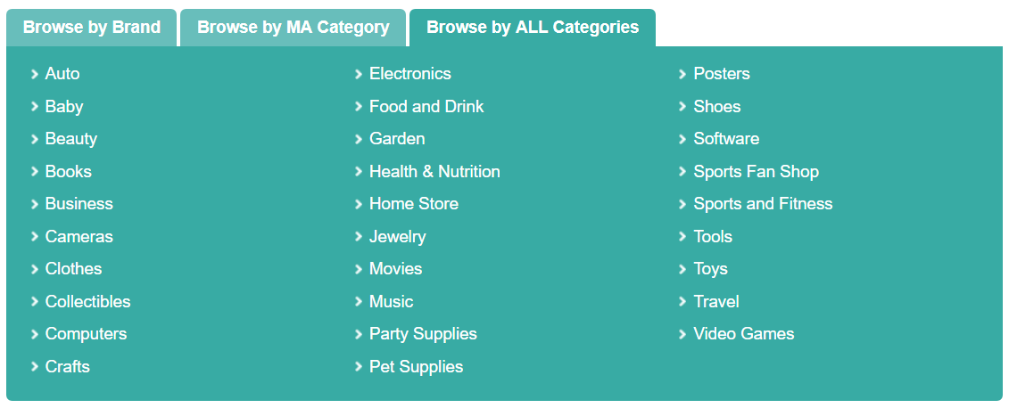
The Future…

Slide 5
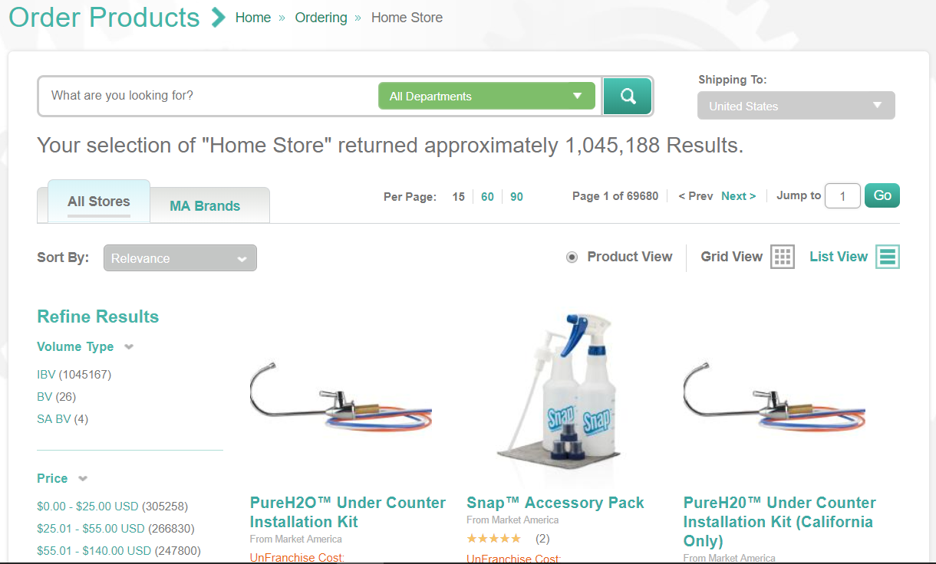

Slide 6
Required Sales = Products x Number of Customers Required
Traditional Business
Market America Business
A small number of products/services
Requires a lot of marketing
Focuses on professionalism and persuasion
To establish market share
The goal is to sell
A large number of products/services
Requires further sales
Focuses on building trust and sharing
To establish customer base
The goal is to promote Shopping Annuity

Slide 7
Objectives of Retailing
Develop a 10-15 repeat customers who purchase ≥ 30 BV/20 IBV monthly
Building share of customer
Retail to recruit

Slide 8
SHOPPING ANNUITY
Change people’s way of shopping by converting their spending into earning. Incorporate with MPCP to achieve residual income.
Everyone has daily expenses. To create a new economy with this buying power through Shop.com, and allows ordinary people to achieve financial freedom. This will change the world.

Slide 9
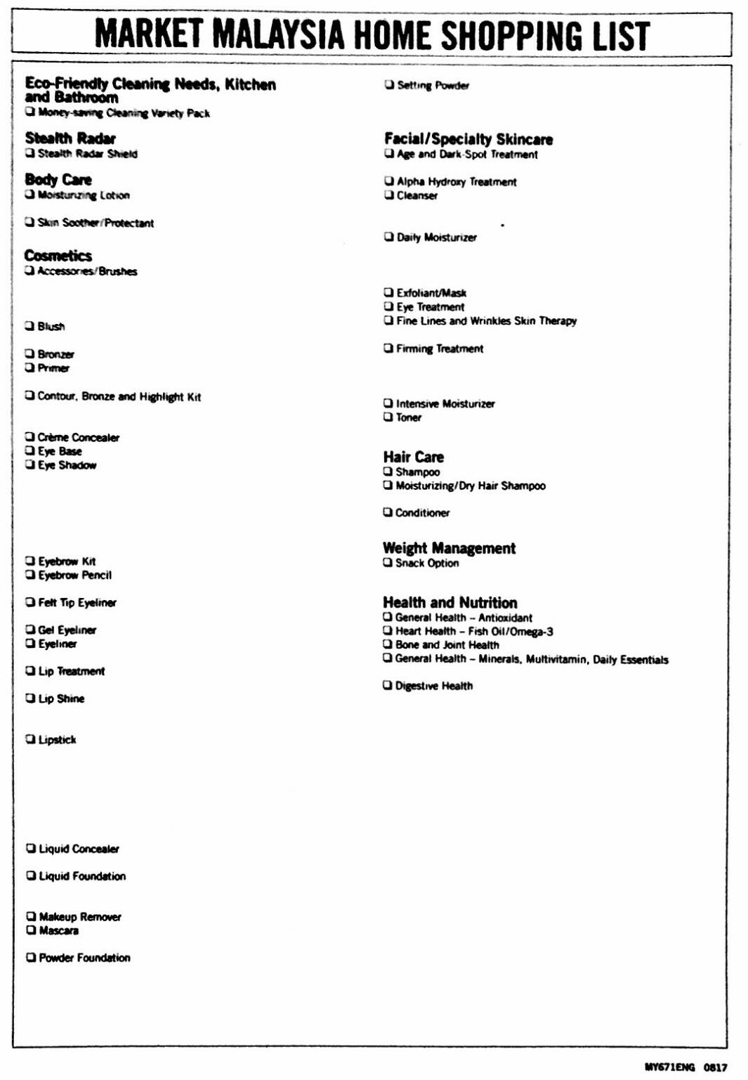
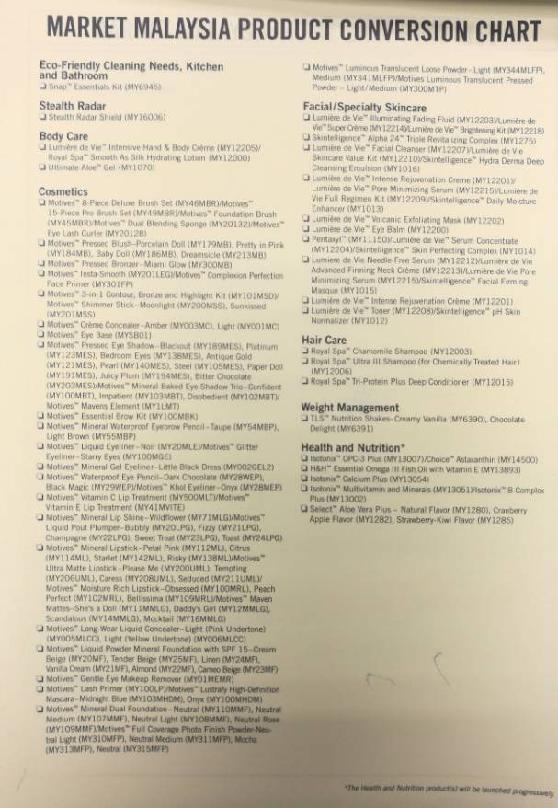
Establish Effective Retail Of Shopping Annuity
Change yourself
Complete Home Shopping List (have experiences to share)

Slide 10
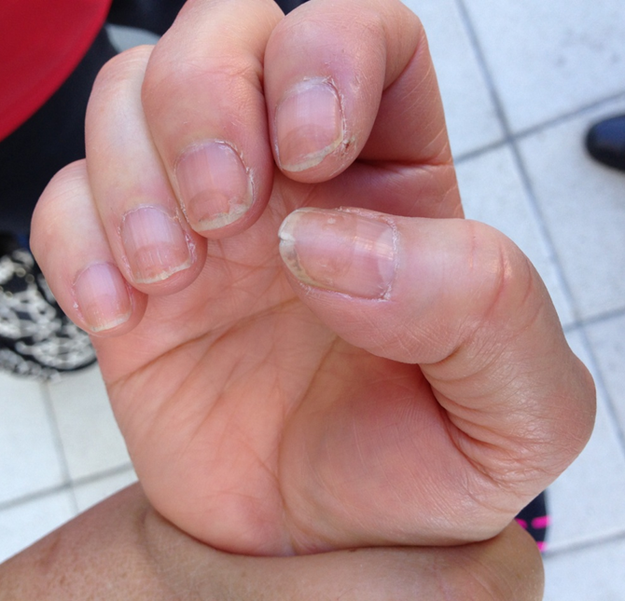
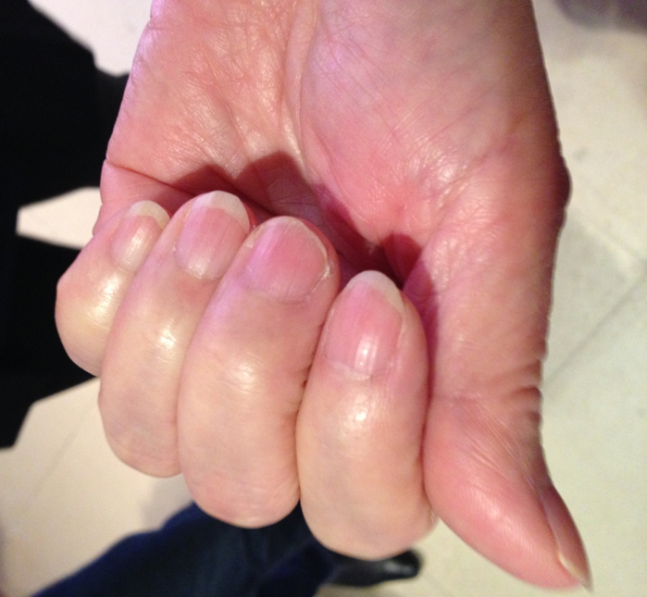
Establish Effective Retail Of Shopping Annuity
Change from yourself
Complete Home Shopping List (have experiences to share)
Product Class, Motives Workshop and Product Seminar (Establish the value of the product)
Spending vs Investment (Establish a low-risk investment)
Photograph the differences, before & after

Slide 11
Establish Effective Retail Of Shopping Annuity
Make a proper name list
Financial ability, trust, love to share and positive attitude
Establish trust
Care about what they care about
Make full use of your free time
Be considerate (E.g. don’t always try to sell them something.)

Slide 12
Establish Effective Retail Of Shopping Annuity
The right products for the right customers
Ask people to complete Home Shopping List (know what they need)
Share stories, photos and experiences (express attitude and value)
Have some sample products with you; ready for others to try
Invite people to a product class, workshop, party, etc.
Share products with those who **believe in you**

Slide 13
Establish Effective Retail Of Shopping Annuity
Follow up
Newly Closed Customers
Day 1 – Thank them for purchasing; ask if they have started using the products
Day 3 – Confirm the proper use of the products
Day 7 – Ask them to share their experience of the product
Day 14 – Share the experiences of other products or items
Day 21 – Customers order again and introduce new referrals
Customer ABC in depth (TRY IT OUT!!)
Show gratitude with sample products and websites navigation (expand customer base)

Slide 14
Establish Effective Retail Of Shopping Annuity
Follow up
Friends and relatives who have not signed up.
Keep in touch and be considerate
Continue to share stories and experiences
One day when they need...
Notes:
Janice & Kawae的示範

Slide 15
Retail to Recruit
Recruit to Retail

Slide 16
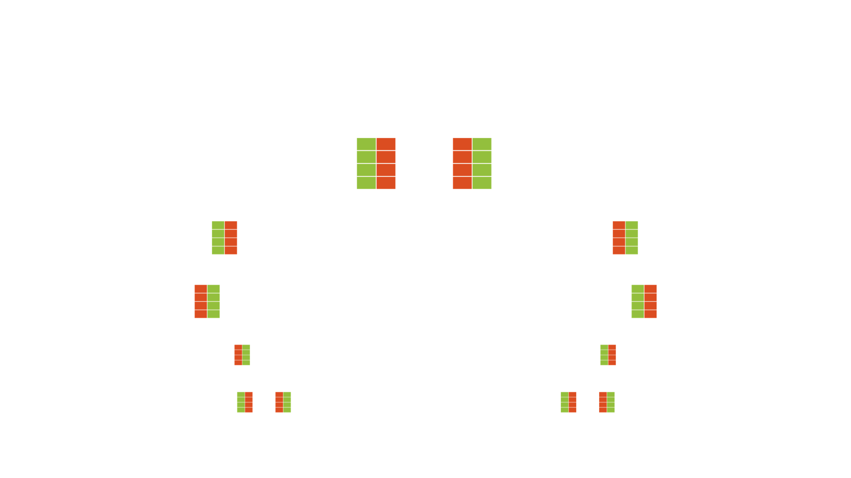
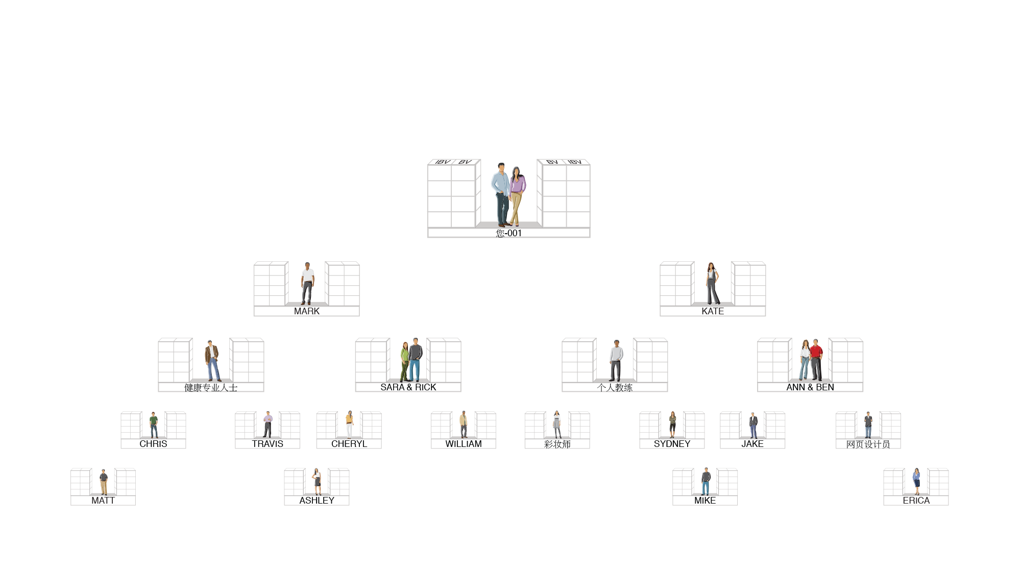
Do the things you never did; Make the money you’ve never made!
OUR TRACKING SYSTEM SEARCHES DAILY TO INFINITY
The system tracks purchases and sales made by you, your customers and your team.
You receive 100% credit for all volume generated within your organization.
genuine
Duplicatable

